Slide 1
Project Analysis Presentation By Benjamin and Shabelyn
Data Analysis of Important Factors in Influences the Used Cars Pricing In India Market

Slide 2

Introduction
This Photo by Unknown Author is licensed under CC BY

Slide 3

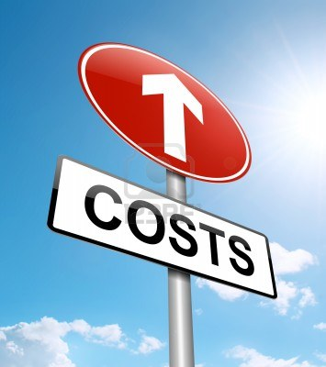
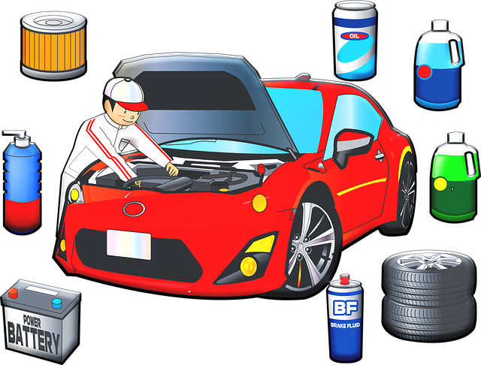
Project analysis slide 6
Introduction
Domain
Background
.
Objective
Growing demand in the used cars in India
The patterns and trends in the types of cars that people are considering reselling in the market.
Awareness of the important features that influences the estimation and evaluation of the used cars pricing.
manually bring their cars down to workshops to estimate the selling price of their used cars.
Efficiency in allocate resources
Save time and cost

Slide 4
Project analysis slide 6
Introduction
Relevant questions to gain valuable insights
Important Factors.
Initial exploring and domain knowledges of the data set, We found that the first group of critical features : KM Driven, Year and Name
second group of important factors such as Transmission ,Owner type, and Location.
Third group of factors are Mileage , Power and Engine
Which resale cars have higher pricing?
2) How does the characteristics of the cars affect the used car pricing?
3) What kind of new car have the high preserve value during resale?

Slide 5
Project analysis slide 2
Project Analysis Flow
Data Understanding
Data Cleaning
EDA
Data Visualization
Conclusion
Machine Learaning
Used Car Price

Slide 6
DATA UNDERSTANDING
There are 6019 rows and 13 columns
Data type summary
2 integers (int64)
2 floating (float64)
9 objects (categorical)
Average :
Year : 2013
KM Driven : 58.738 KM
Seats : 5
Price : 9.48 Lakh

Slide 7
Project analysis slide 6
Project Analysis
Dataset : Used car About dataset Definitions of the columns are found below.
Attribute | Description
Name | The brand and model of the car
Location | The location in which the car is being sold or is available for purchase
Year | The year or edition of the model
Kilometers_Driven | The total kilometer driven in the car by the previous owner(s) in KM
Fuel_Type | The type of fuel used by the car
Transmission | The type of transmission used by the car
Owner_Type | Whether the ownership is Firsthand, Second hand or other
Mileage | The standard mileage offered by the car company in kmpl or km/kg
Engine | The displacement volume of the engine in cc
Power | The maximum power of the engine in bhp
Seats | The number of seats in the car
New_Price | Price of new model
Price | The price of the used car in INR Lakhs
Note: A lakh is a unit in the Indian numbering system equal to one hundred thousand

Slide 8
Data Cleaning
Conversion categorical data to numeric data types (Continues variables):
Engine
Power
Mileage
New Price
Split the name:
Split the Name Column into Brand , Model, Variant (New Columns )
Create new columns
(a) Create new columns for Year (b) Create a new columns for KM Driven
Check the missing values:
1) Mileage : 2 2) Engine : 36 3) Power : 36 4) Seats : 42 5) New Price : 5195
Checking on Duplicate data
Checking on the outliers:
(a) Seat (b) Year (c) Price (d)KM_Driven

Slide 9
Project analysis slide 5
Missing Values
New Price
86% missing value.
produce valuable insights
Mileage
2 rows affected
Minor issue in affecting the data analysis
Impute the missing values using mean by matching the same model ,brand and variant .
Drop the missing values
Power and Engine
36 missing values.
Imputation with median the missing values
Seats
42 missing values.
Impute the missing values with mode
Mode : A number that appears most often

Slide 10
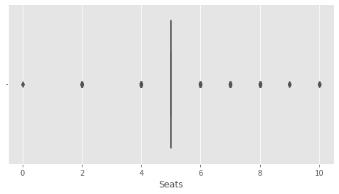
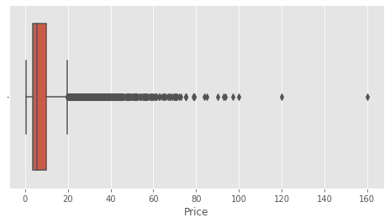
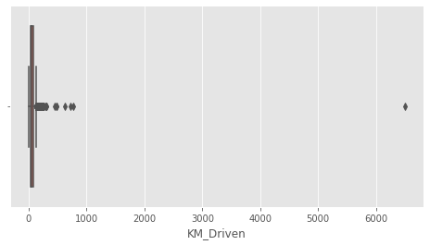
Project analysis slide 5
Outliers
An outlier is an observation that lies an abnormal distance from other values in a random sample from a population.
Zero Seats
Seats
Inspection of cars with zero seats
Audi A4 3.2 FSI Tiptronic Quattro
Price
160 Lakh
Land Rover Range Rover 3.0 Diesel LWB Vogue
120 Lakh
Lamborghini Gallardo Coupe
Replace the car seat with 2 seated
Let it be
Not surprise that we have significant outliers values.
Kilometres Driven
Inspection of KM driven of 6,500,000 KM
BMW X5 xDrive 30d M Sport Chennai 2017 Diesel Automatic First
Drop the outliers
Price
KM Driven

Slide 11

Exploratory Data Analysis And Data Visualization

Slide 12
Project analysis slide 10
.
Brand
The brand of the vehicle could have significant impact on the used car resale value, regardless of the quality or condition of the car.
.
How many brand are there in the market ?
There are 30 brand in the used cars data set.
Which brand are the most in the market?
maruti 1211
Hyundai 1107
honda 608
Toyota 410
Mercedesbenz 318

Slide 13
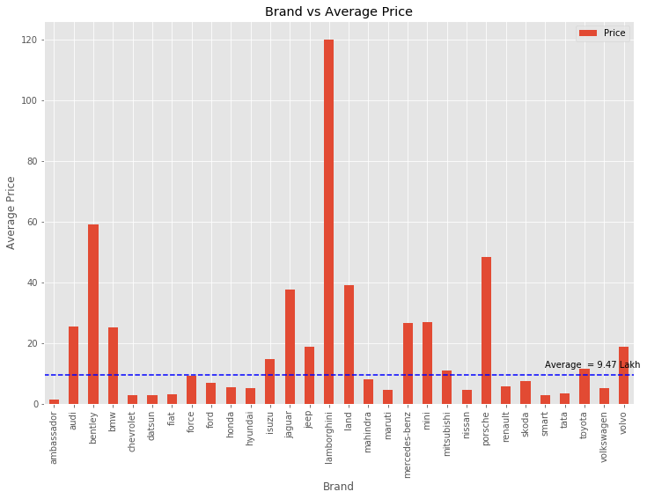
Project analysis slide 10
Brand
Observation
From the graph:
Maruti, Hyundai and Honda domain the market with 20% ,18% and 10% . The price are slightly below the average price.
For Toyota, Mitsubishi, Force, and Isuzu are above the average price in the market.
Even though the model car for Japan and German have the high retain values in resale market, but the local brand Maruti seems has high demand in used car market.
Reason behind could be associate to the buying power and affordability of the consumers in India.

Slide 14
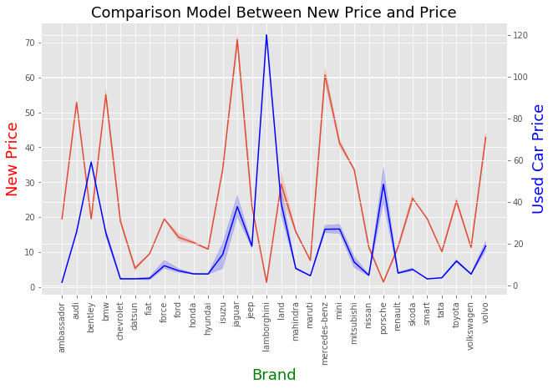
Project analysis slide 5
New Price vs Used Price
Maruti Suzuki India Limited, formerly known, is an Indian automobile headquartered in New Delhi.--- Google search
The Datsun is an automobile brand owned by Nissan. (japan)
Mahindra & Mahindra Limited , Indian multinational vehicle , headquartered in Mumbai, Maharashtra, India
Observation
The gap between the new cars price and the used cars can tell which Brand have a good preserve values during resales.
There are : Honda, Hyundai, Isuzu, Toyota , Datsun and Maruti, Mahindra
General information : Google search
Honda, Hyundai, and Toyota rank at the top in the mass market for retaining higher resale values while Lexus, Acura, Infiniti, Mercedes, and Audi fare best in terms of luxury brands.
All of these brands can retain around 45-60% of their value in the first three years of ownership compared to only 35% for other brands in the same amount of time.

Slide 15
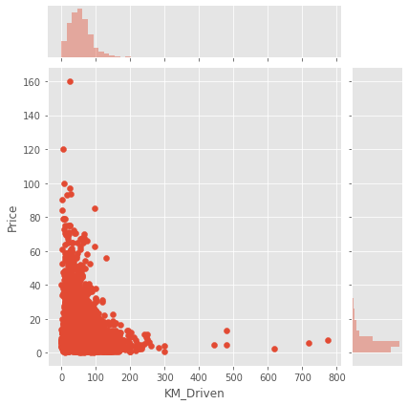
Project analysis slide 10
Kilometres Driven
KM Driven vs Price
Is a good indicator of the vehicle's wear and tear.
Observation
Obviously, the higher the kilometers you have drive , the lower the used cars price.
A car with high KM Driven means that the cars has been used through and through.
From consumers perspective, the first problem that used car owners need to solve is the issue of maintenance. Hence, The higher the KM driven could have the higher likelihood of breaking down. For this reason, buyers would usually prefer to spend more money on a vehicle with lower kilometer drive instead. A used car tends to have more wear and tear than a brand new car.
A used car with low KM Driven could have gold mine in the market and this would be a crucial features in used cars pricing determination.

Slide 16
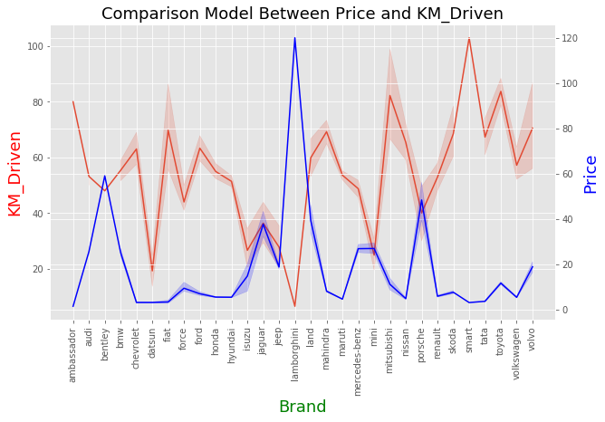
The luxury sport cars such as BMW ,Audi, Jaguar, Mercedes-benz, Mini, Porsche have the good preservation values regardless of KM Driven.
The luxury cars are more expensive. Datsun ,Toyota, Honda have the good preservation values of used car market in considering the affordability .

Slide 17
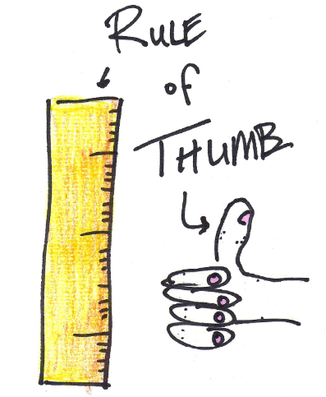
Project analysis slide 10
Kilometres Driven
Google search:
As a rule of thumb, the average car will rack up 20,000 km per year — the distance manufacturers use to determine standard warranty coverage.
A seven-year-old model should have 140,000 to 150,000 km on the odometer. If it has traveled considerably more, deduct cash for high mileage.
May 27, 2011

Slide 18
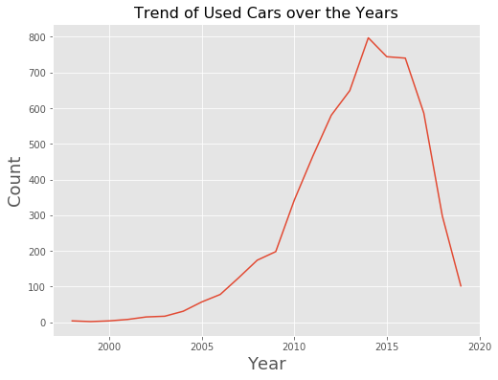
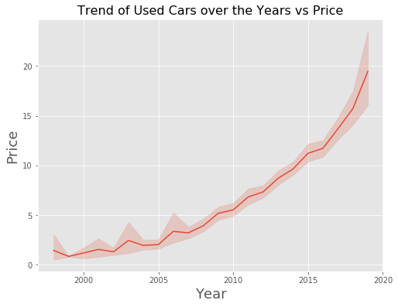
Project analysis slide 10
Year
The lifetime for the vehicles.
Observation
Can see from the line plot above , the used cars edition from year 2010 to 2014 being resell in the market increase dramatically and drop faster for the car with edition year of 2015.
We can assume that the owner will keep using the cars if the cars' age are within 5 years and will consider to resell to market after 5 years.
Year
Observation
From the line chart:
It's a very simple interpretation of relationship between year and car. The year and price are related positively. The younger the age of the car the higher the price.

Slide 19
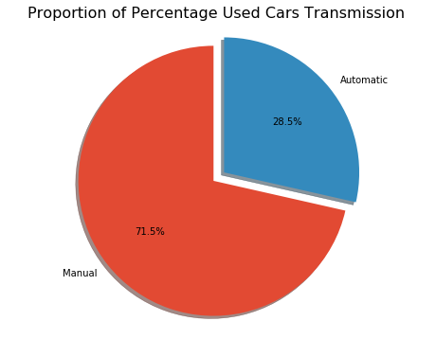
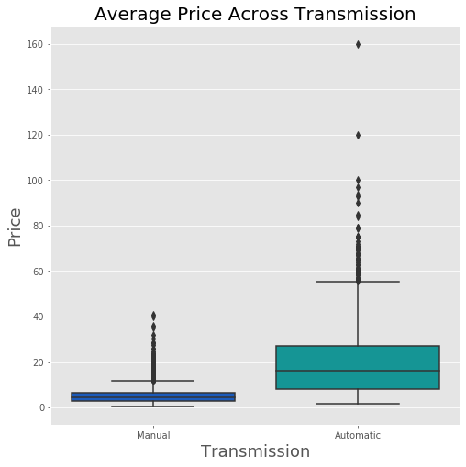
Project analysis slide 10
Transmission
Referring to the gearbox in the car
How about the percentage of Used Cars Transmission?
There are 71% of the used cars are manual cars. Majority of the car owner tend to get rid of the manual cars .
Observation
From the boxplot:
The price for automatic vehicles are more higher than the manual vehicles.
Demand and supply power.

Slide 20
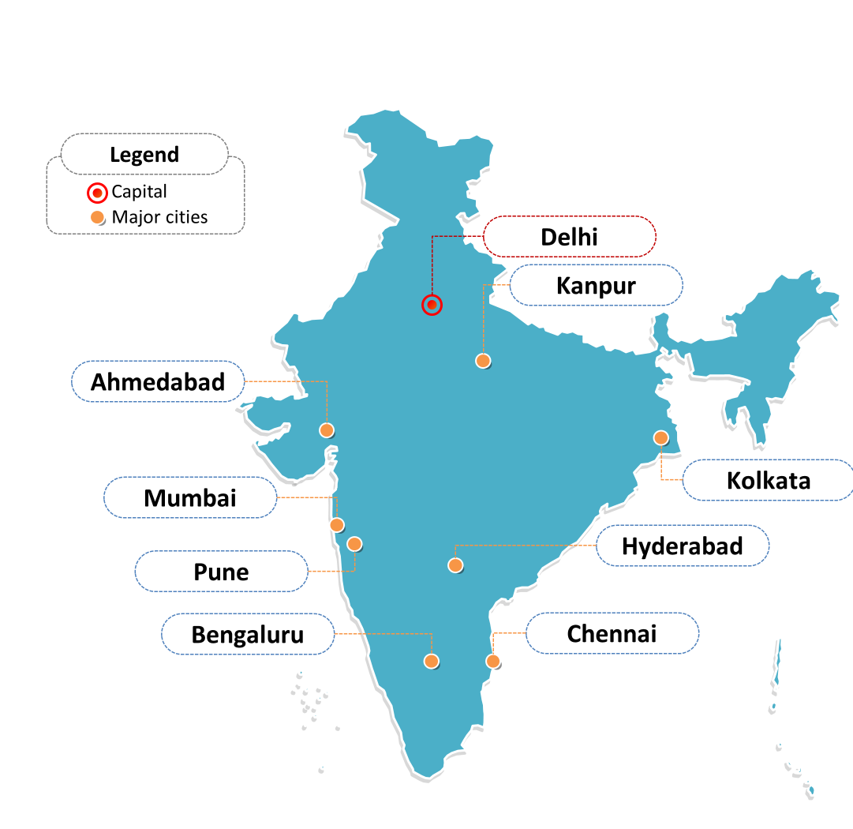
Used car Price ranking in 10 major cities and capital
Mumbai has the most used car of 784 in total follow by Hyderabad , 741 and Kochi, 648
Mumbai (formerly called Bombay) is a densely populated city on India’s west coast. A financial center, it's India's largest city.
6. 554
9. 413
Jaipur
7. 535
1. 789
5. 622
2. 742
The city's also famous as the heart of the Bollywood film industry.---Google search
Population: 18.41 million (2011)
10. 358
8. 492
3. 651
Kochi
Coimbatore
4. 636

Slide 21
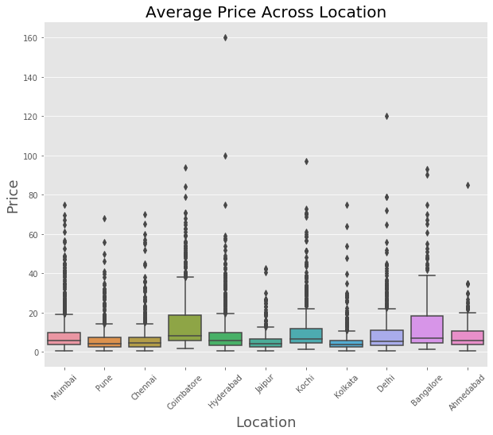
Observation
From the boxplot:
The price of the used car for Coimbatore , Kochi, Bangalore and Ahmedabad are higher comparison to other locations.
Mumbai are the highest in total but the price lower than Coimbatore.
The price of the car could influences by the weather based on the location you stay.
Where you live can significantly influence its resale value.
Google search : West coast (MUMBAI) of India may get heavy rainfall; forecasts PIK SECTIONS West coast of India may get heavy rainfall; forecasts PIK Read more at: https://economictimes.indiatimes.com/news/politics-and-nation/west-coast-of-india-may-get-heavy-rainfall-forecasts-pik/articleshow/75679929.cms?utm_source=contentofinterest&utm_medium=text&utm_campaign=cppst

Slide 22
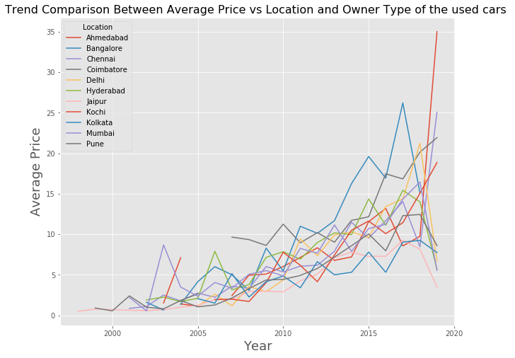
Ahmedabad
Observation
The average price range are different from all over the India.
With comparison among the year and average price, we found that :
The cars prices are increasing for the following location compare to the others:
Ahmedabad
Chennai
Coimbatore
Kochi
2. Chennai
3. Coimbatore
4. Kochi

Slide 23
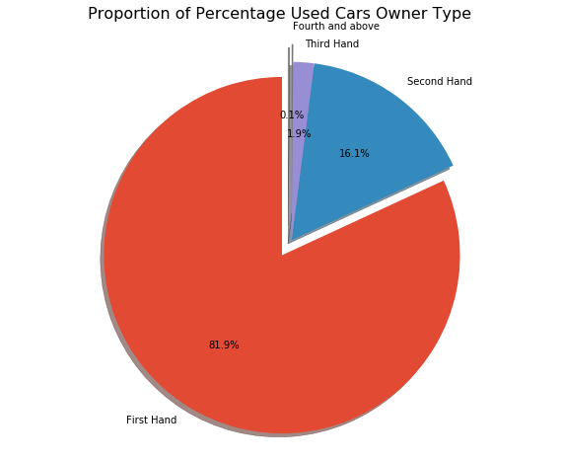
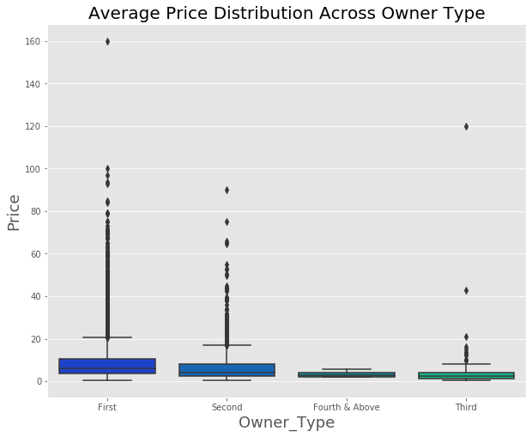
Project analysis slide 10
Owner Type
Observation
Total of the first hand cars in the market is 4889 which is covered 82% in the market. Why?
Covid-19 pandemic has affected the economy badly.
Due the high rate of unemployment and retrenchment,
owner who not affordable to continuing paying the installment will consider to sell the car.
On the other hand , the used car market is one of the hottest, coronavirus markets for consumers.
Observation :
The average price drop gradually from first hand cars to second hand cars and so on.
Means that the more the cars transfer to different owner the more depreciated the value of the cars.

Slide 24
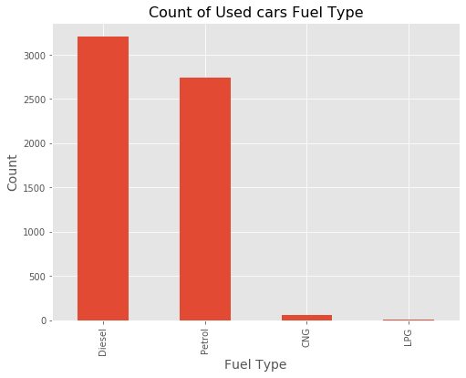
Project analysis slide 10
Fuel Type
A fuel is any material that can be made to react with other substances so that it releases energy as heat energy or to be used for work.
Maintenance
gasoline engine
200,000 miles
diesel engines
1,000,000-1,500,000 miles
Driving experience
less noisy.
Benefits of Diesel engines
Cheaper
Efficient
power
Petrol now costs Rs 83.71 in Delhi and Rs 90.34 in Mumbai while diesel is available for Rs 73.87 in Delhi and Rs 80.51 in Mumbai. (Google search on 16 Dec 2020, 7:20pm)

Slide 25
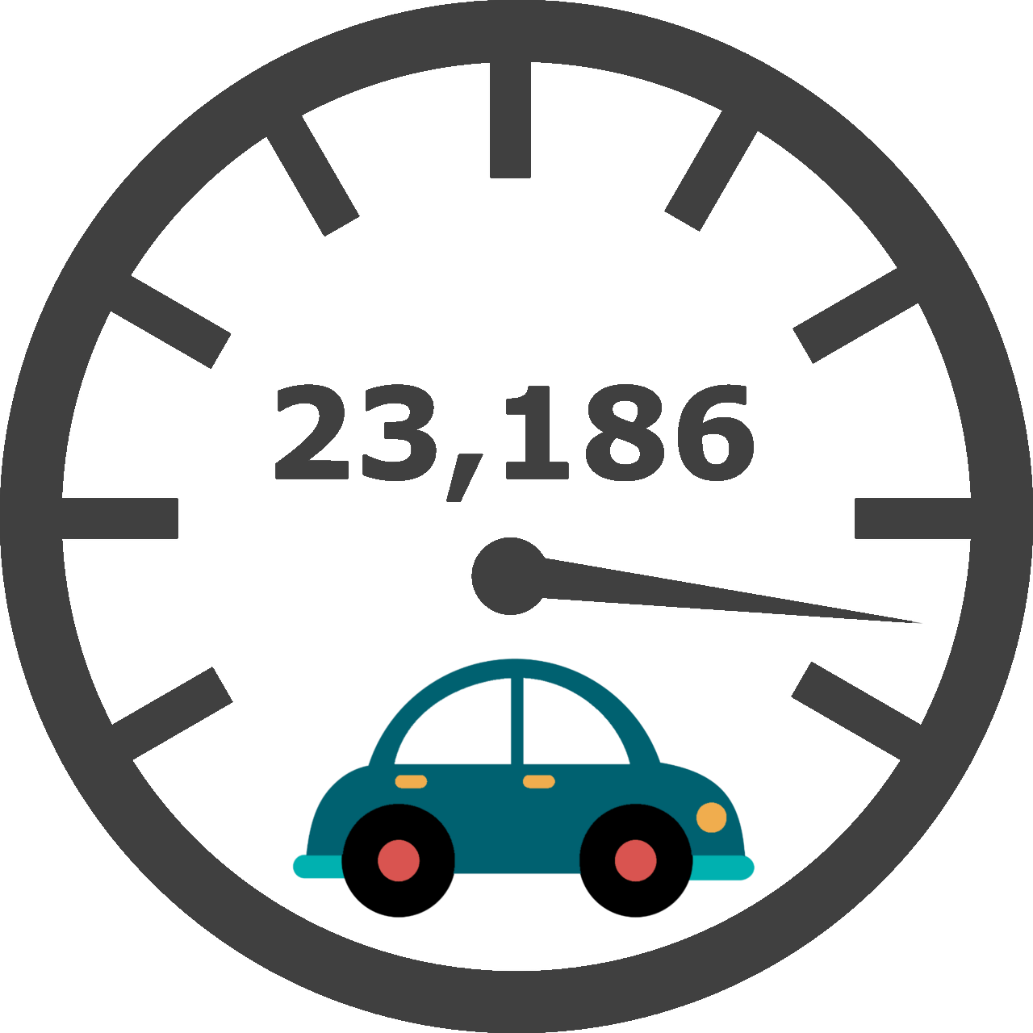
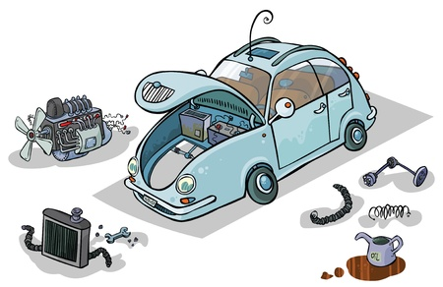
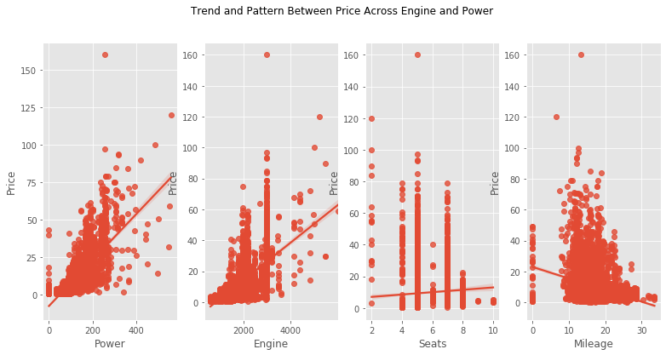
Project analysis slide 8
Power,Engine,Seats and Mileage vs Price
Engine is the heart of the car, convert heat from burning gas and move the vehicle.
The relationship between seats and price are not strong , but can see the more seats of the cars the price slightly higher.
Power is about the speed of the cars
Seats
Power ,Engine
Mileage
The power and engine are positive related to price.
The more better the performances of the power and engine, the better of the price.
Obviously the relationship of the Mileage and Price are negatively related. The Mileage for the cars are compound around 10 kmpl to 20 kmpl

Slide 26

Machine Learning

Slide 27
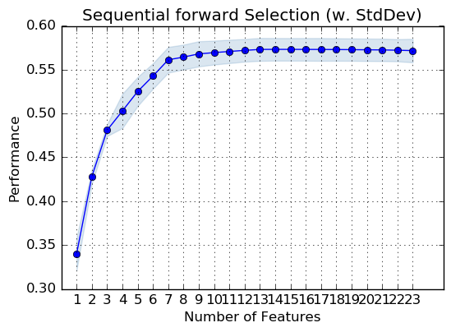

Accuracy Comparison
Accuracy less than 5 , consider not so well .
Algorithmn | Accuracy
Linear Regression | 0.56
Linear Regression with important features | 0.56
XGBoost regressor | 0.69
XG Boost with important features | 0.68
Random Forest Regressor | 0.75
Random Forest Regressor (Tune with Hyperparameter and Grid search CV ) | 0.75
top 5 features importance to tune the Random Forest Regressor | 0.68
'Location_Bangalore',
'Location_Coimbatore',
'Location_Hyderabad',
'Location_Kochi',
'Location_Kolkata',
'Location_Mumbai',
'Fuel_Type_Diesel',
'Fuel_Type_Petrol’,
'Transmission_Manual',
'Mileage_bin',
'Seats_bin',
'Year_bin',
'Power_quantile_label',
'KM Driven_log'
WOW !! There are so many features …
How I know which one is the most important ???

Slide 28




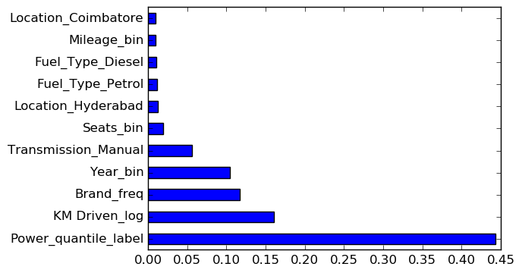
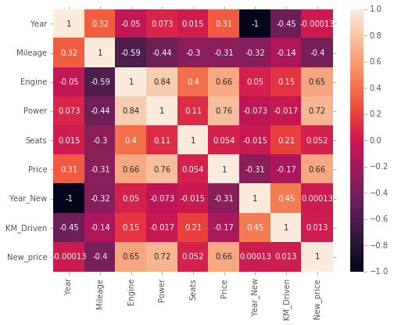
Project analysis slide 10
Conclusion
Relationship Between
Features and Used Car Price
Kilometres Driven
Mileage
Engine
Power
Year
Cor-relationship of Features and Price
Random Forest Features Importance

Slide 29
Thank You

